Slide 1
SCDRS Restoration summary by project

Slide 2
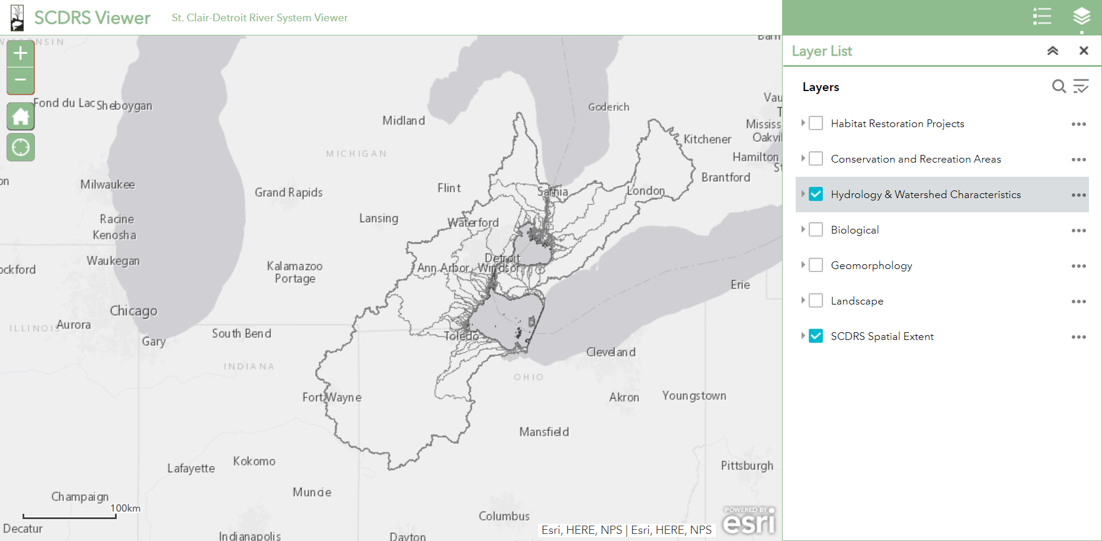

Slide 3
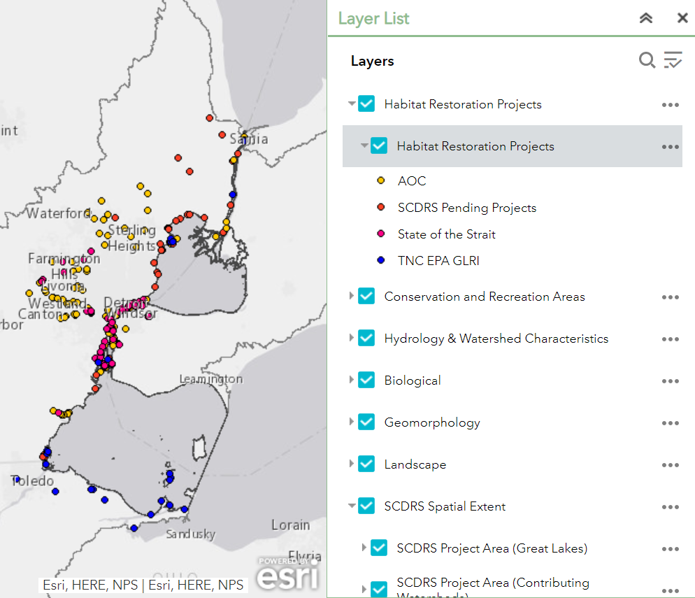

Slide 4
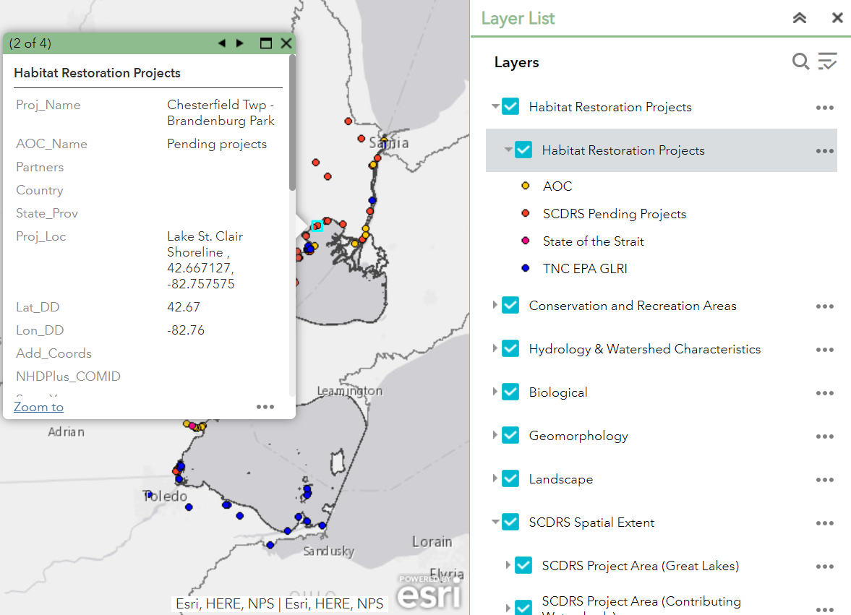

Slide 5
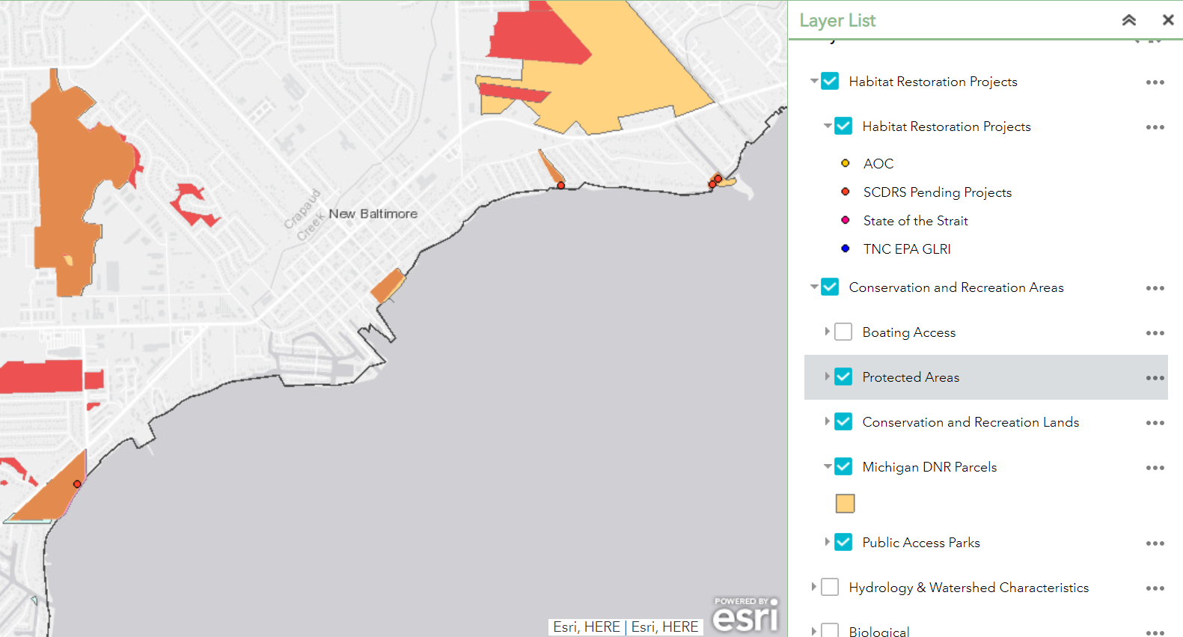

Slide 6
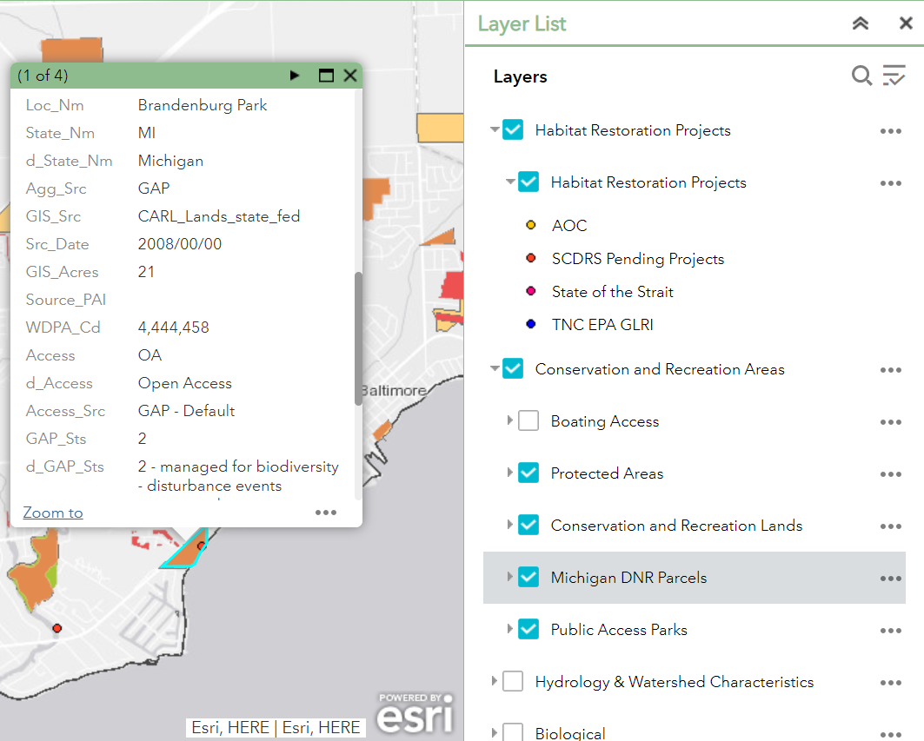

Slide 7
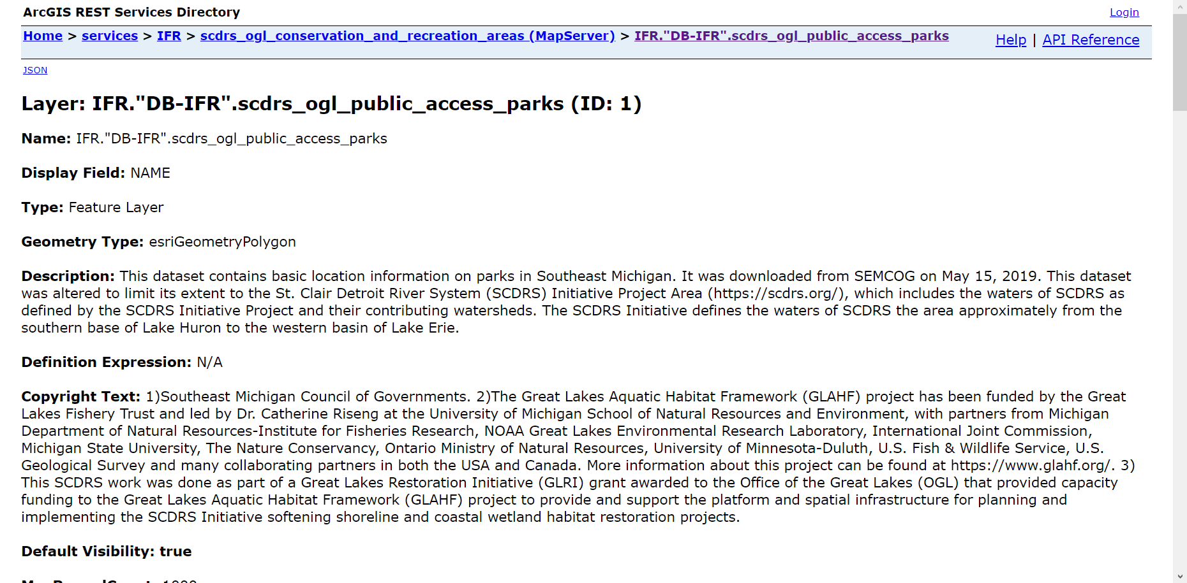

Slide 8
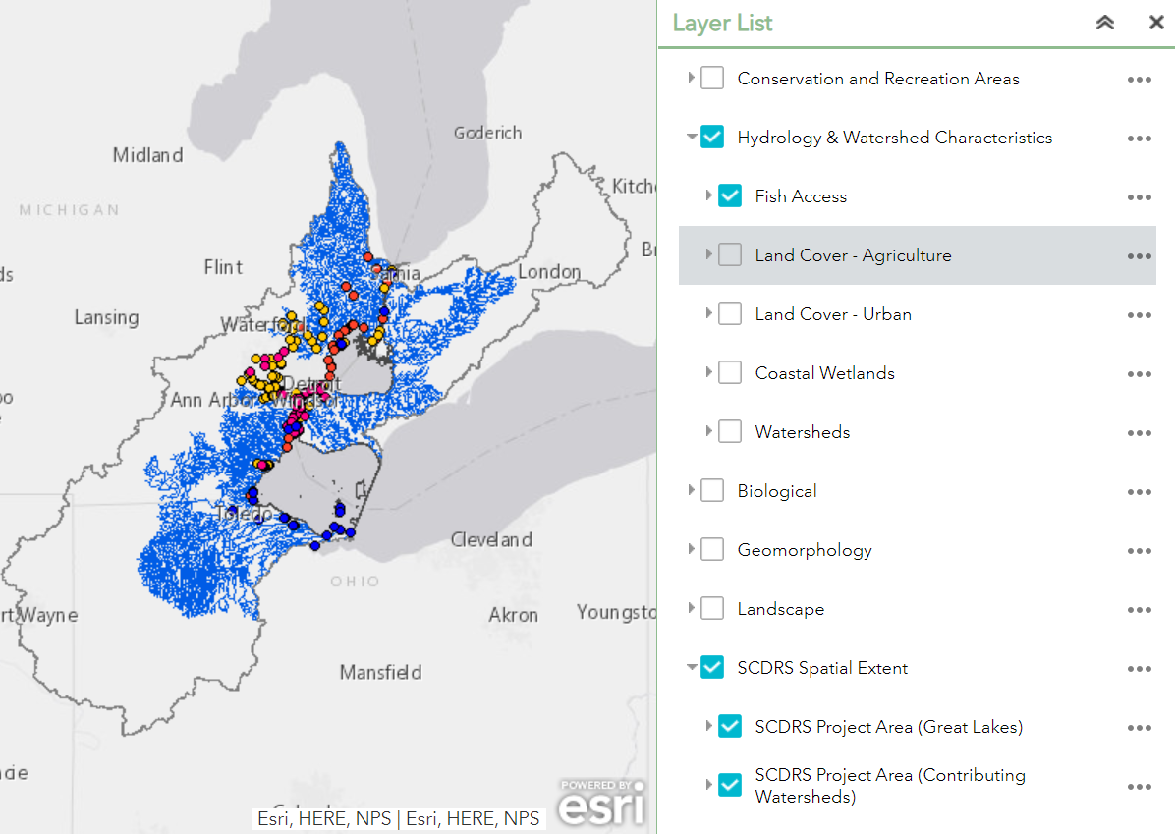
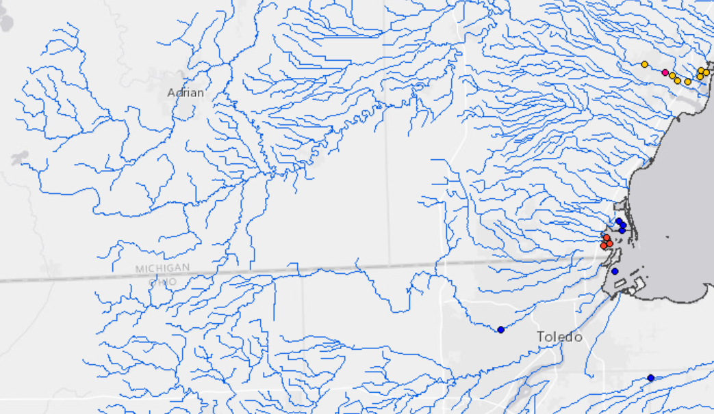
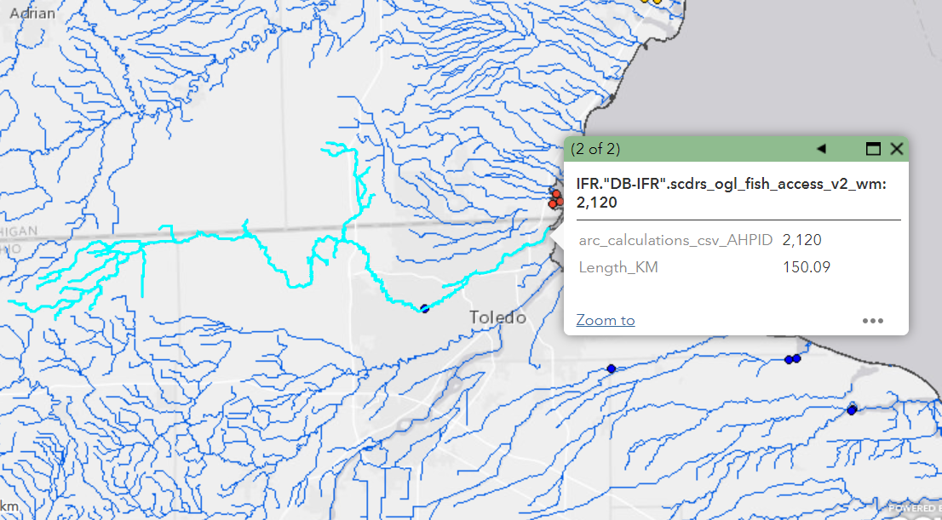

Slide 9
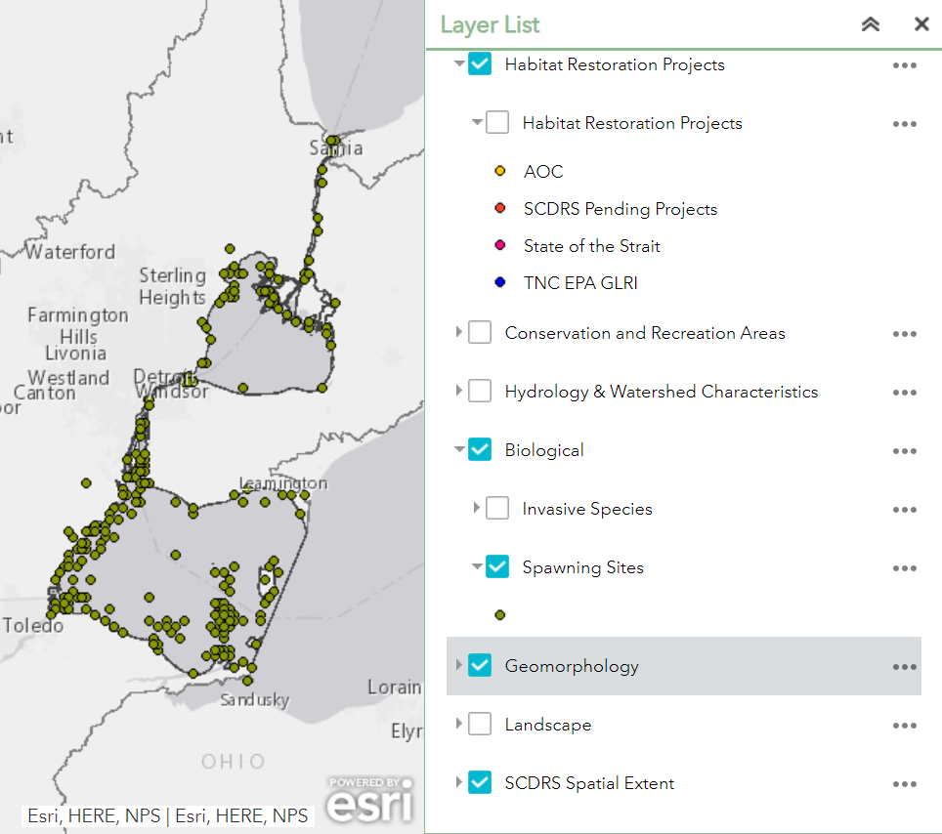
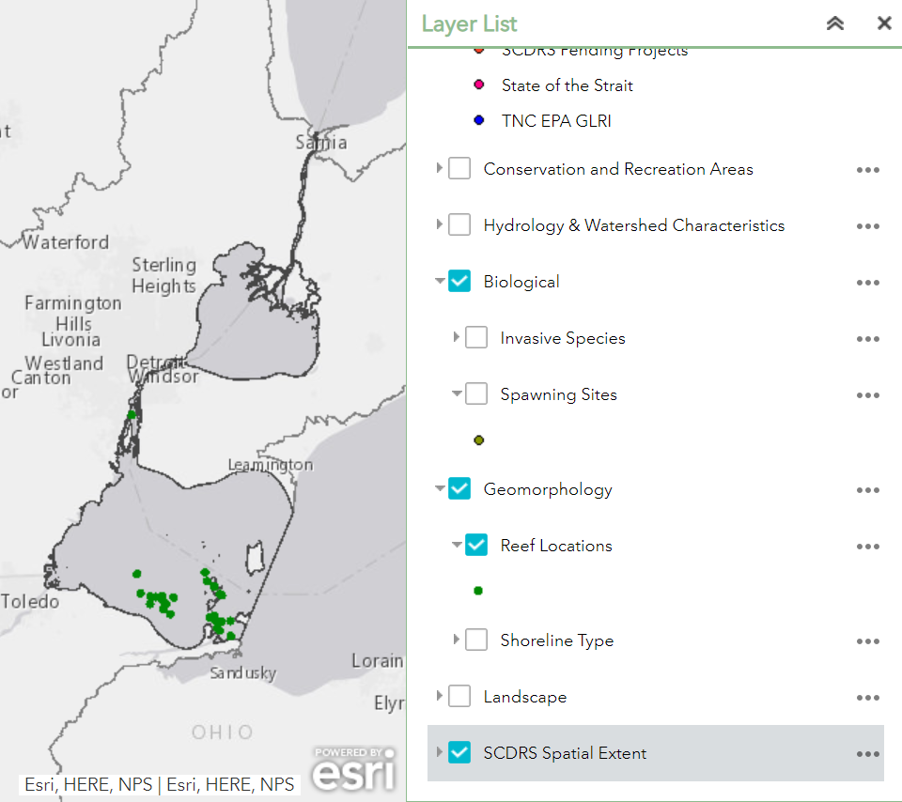

Slide 10
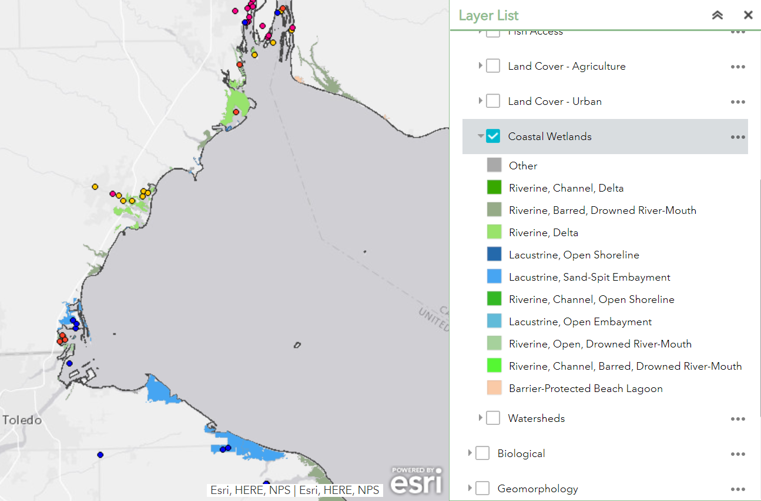
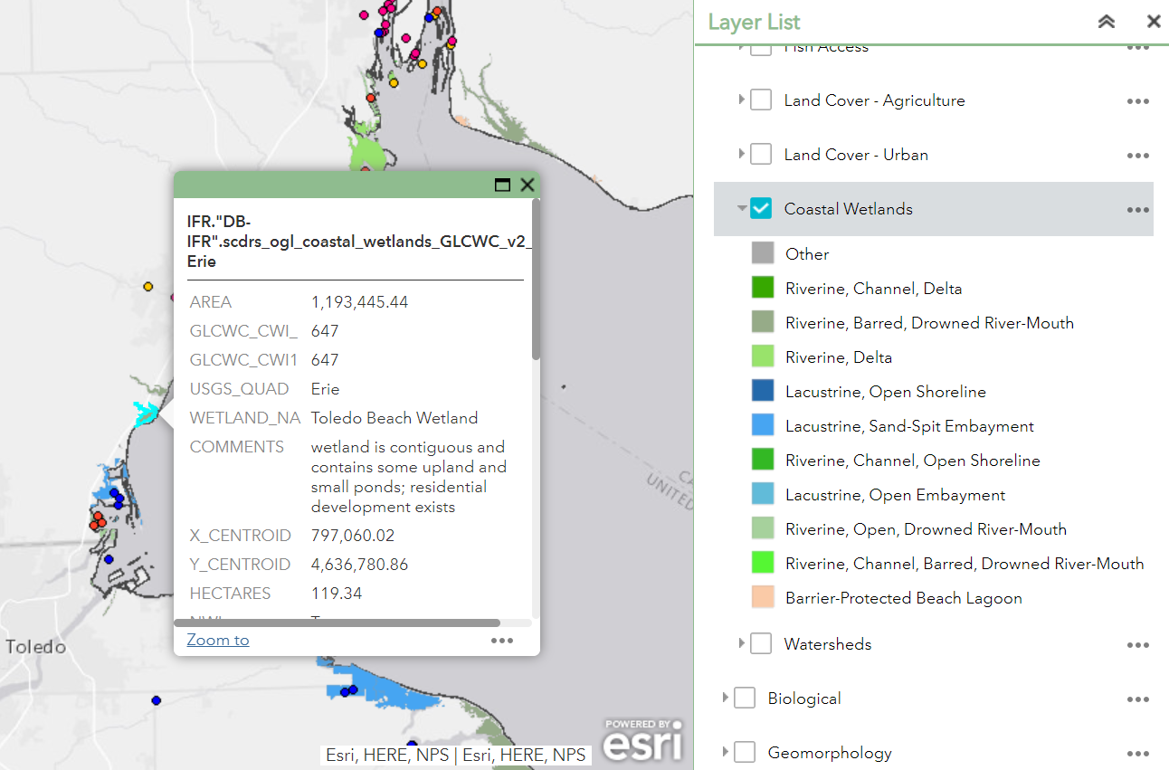

Slide 11
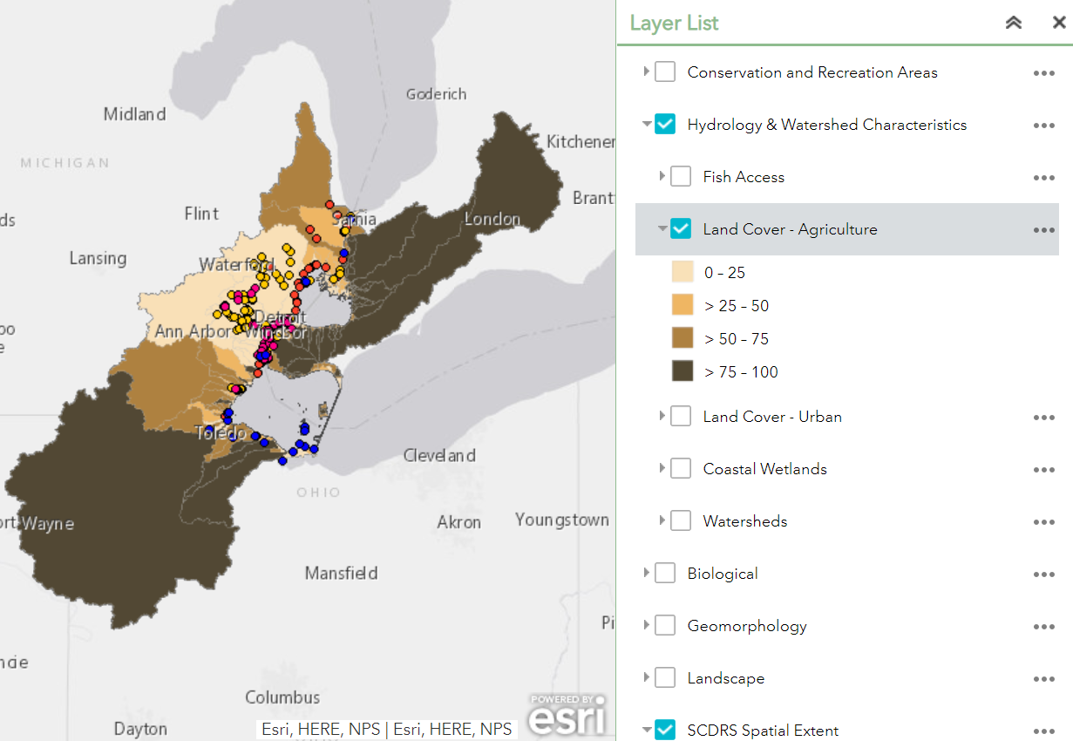
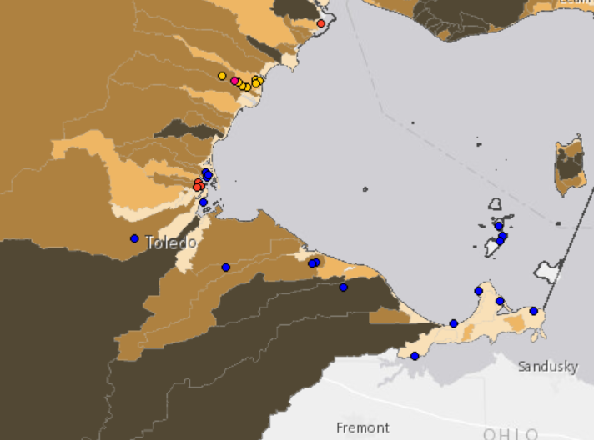
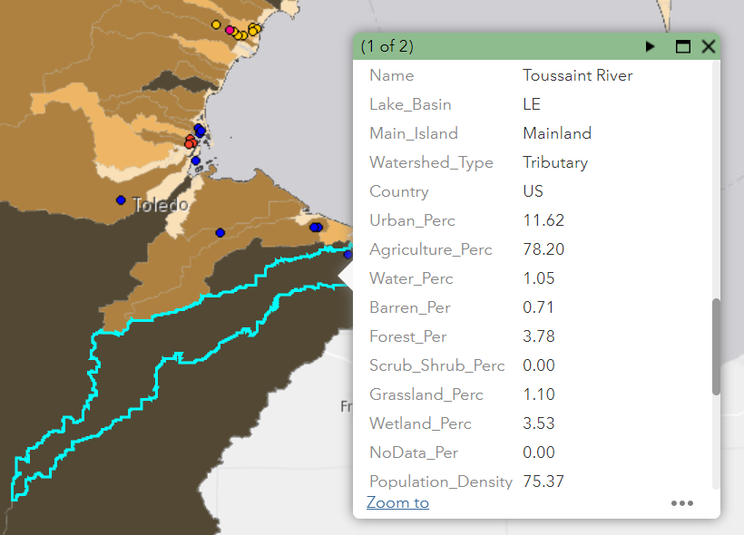

Slide 12
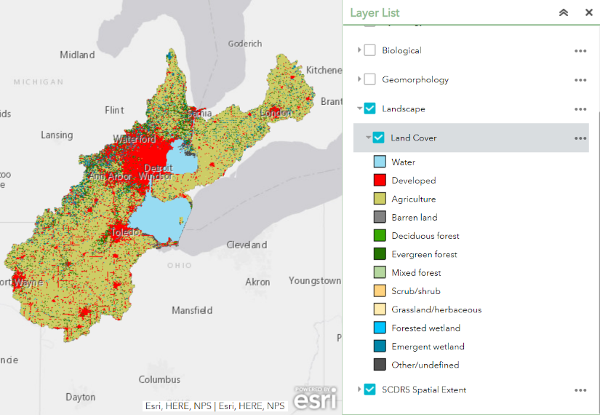

Slide 13
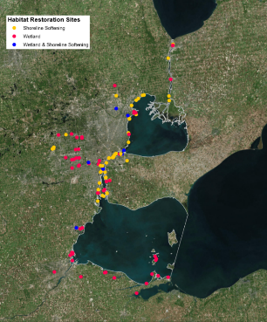
NEXT STEPS
Project website and viewer is live on GLAHF.org under Projects
Revise viewer based on SCDRS feedback
Can update viewer for TNC, EPA, GLRI restoration extent with SCDRS help
Can incorporate additional restoration project data if data are input into SCDRS database
Use maps and summary data to evaluate existing and proposed restoration sites and prioritize areas where further restoration is needed

Slide 14
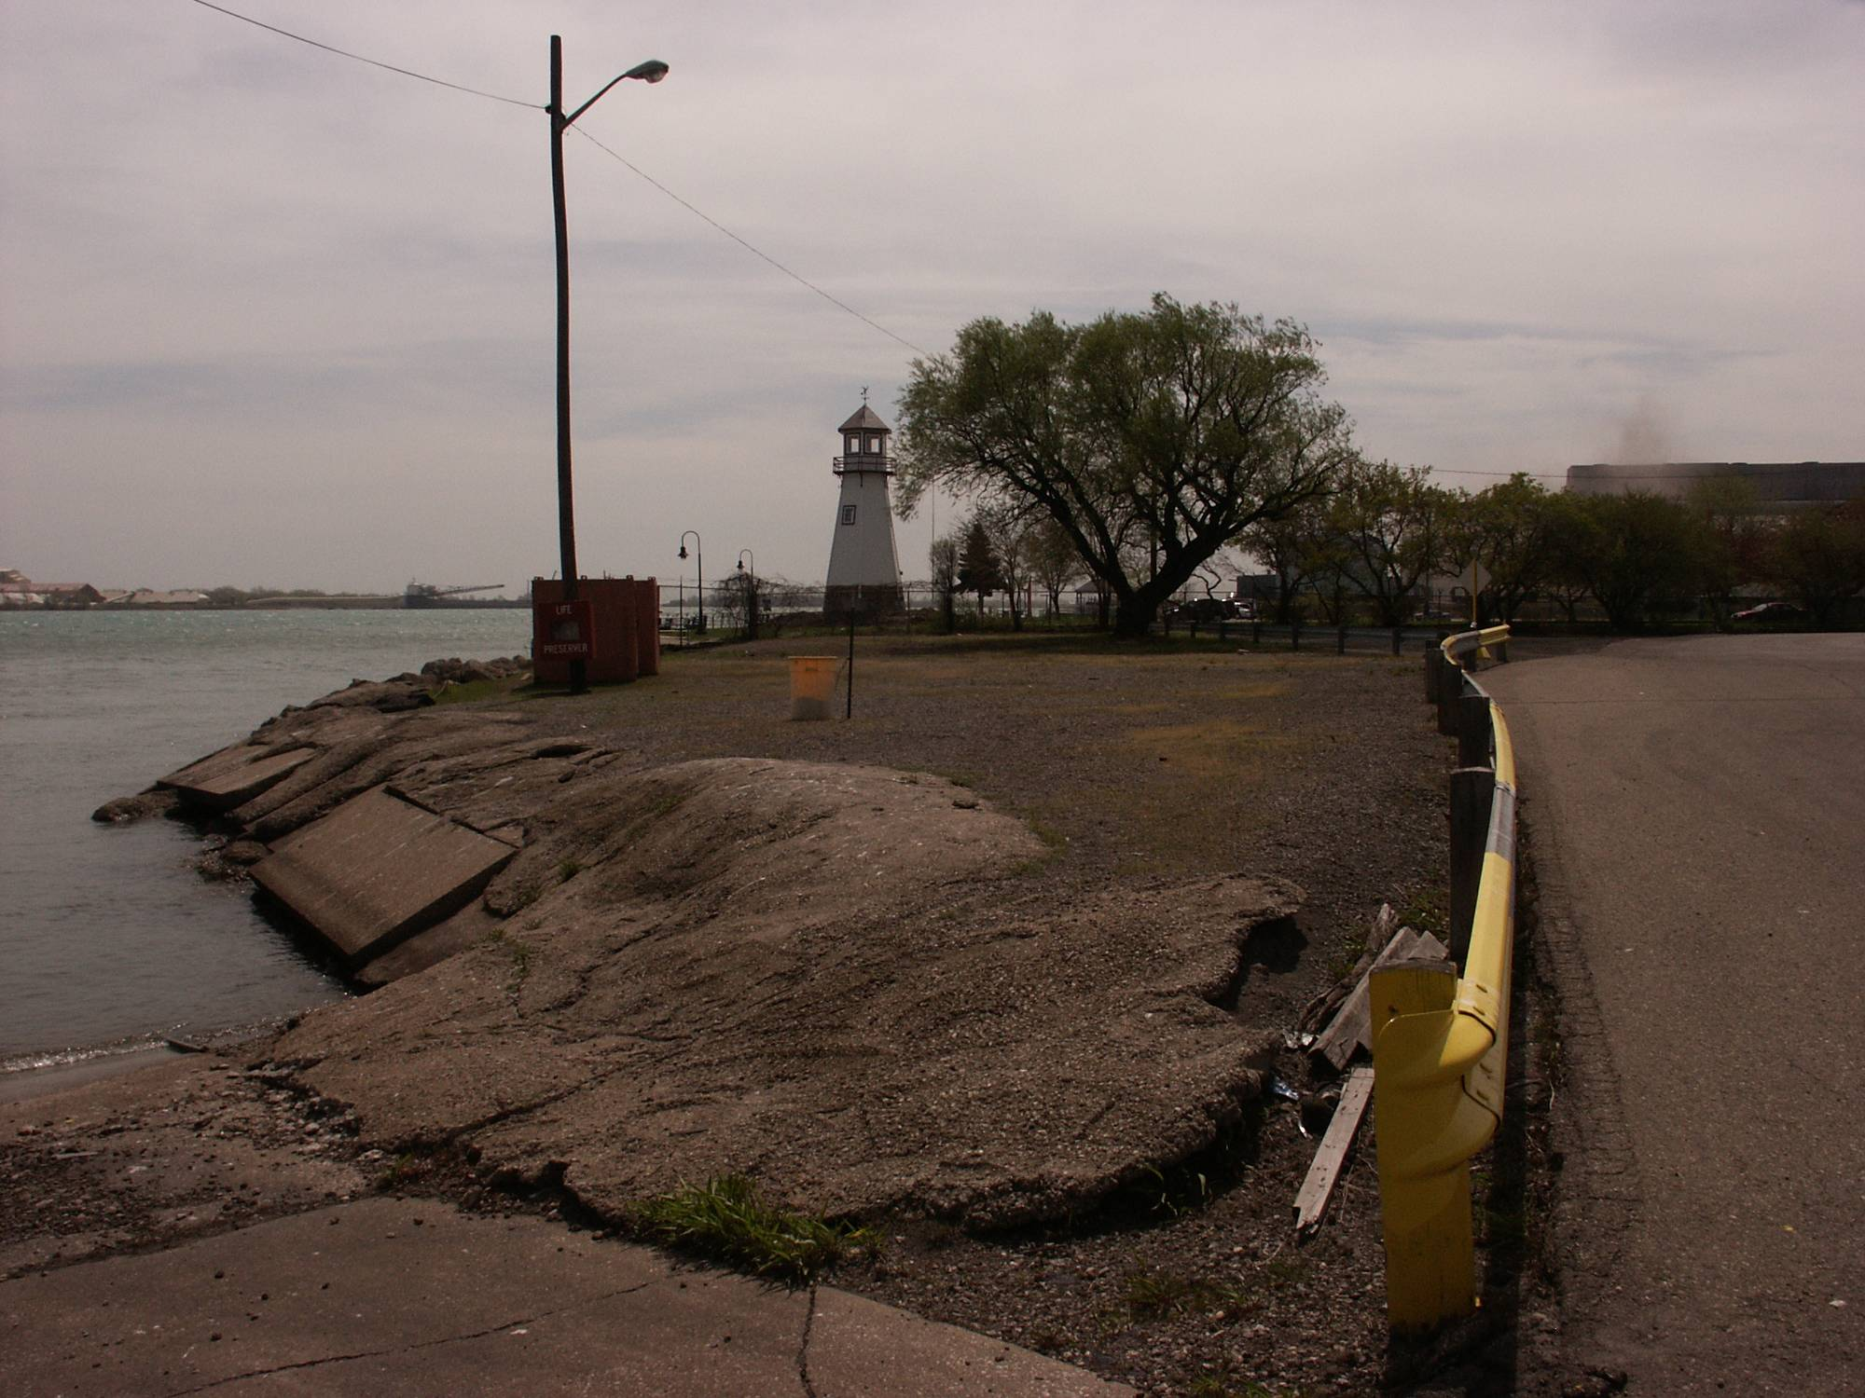
BEFORE Restoration (2006)
DTE Energy

Slide 15
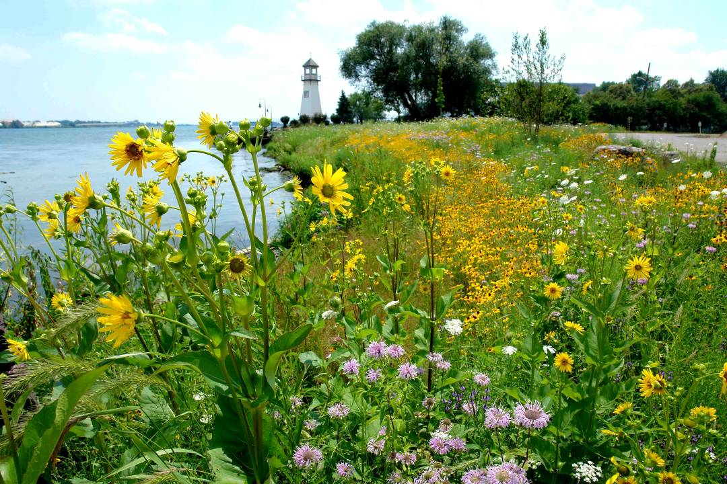
AFTER Restoration (2008)
THANK YOU
Questions?
DTE Energy

