Slide 1
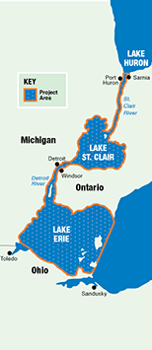
St. Clair – Detroit River System Initiative (SCDRSI) Virtual AGM 2020 Webinar #5

Slide 2
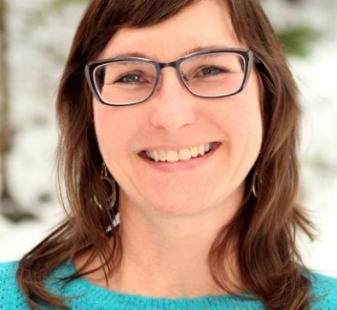
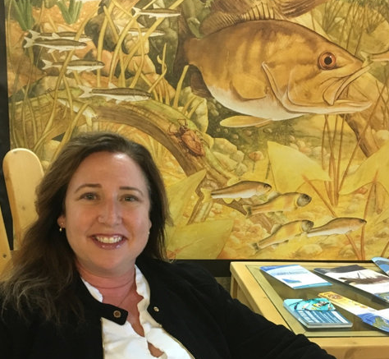
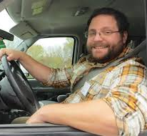
Welcome & Protocol
Thank you for participating in the 2020 Virtual Annual General Meeting: Webinar #5 for the St Clair-Detroit River System Initiative!
Today we are anticipating ~65 participants on the webinar.
Please keep phones and computers on mute to avoid feedback until open question period.
Please use the chat function if you are having issues or if you have questions during the meeting.
The webinar cannot be recorded but minutes and presentations can be provided.
Michelle Selzer
U.S. Co-Chair
SCDRSI
Susan Doka
Cdn Co-Chair
Jesse Gardner Costa
SCDRSI Scribe

Slide 3
Tribal and First Nations Acknowledgement
These ancestral lands are recognized in the St Clair – Detroit River System Initiative’s extent:
Meskwahkiasahina
Peoria
Attiwonderonk
Anishnabewaki
Bodewadmiakiwen
Miami
In particular our members from the Heritage Centre @ Walpole Island First Nation (Bkejwanong unceded territory)
Anishinaabe
SCDRSI
Source: native-land.ca

Slide 4
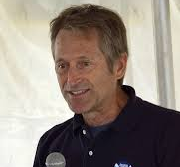
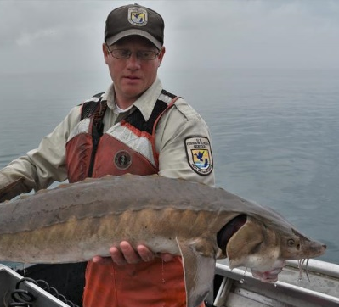
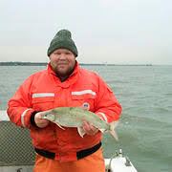
Agenda – Webinar #5
Duration: 1.0– 1.5 hours max
Talk #1: Great Lakes Aquatic Habitat Framework project in the SCDRS
Catherine Riseng and Kevin Wehrly
Questions (Terry)
Talk #2: SCDRS wetland restoration project overview
Jill Estrada
Questions (Terry)
Status Assessment Review and Next Steps
Justin Chiotti and Ed Roseman
Open Discussion (Michelle)
Closing Remarks (Sue)
Terry Heatlie
Communications Lead
SCDRSI
Justin Chiotti
SciMon Co-Lead
Edward Roseman
SciMon Co-lead

Slide 5
Talk #1: Great Lakes Aquatic Habitat Framework SCDRS coastal wetlands and shoreline assessment project
Catherine is a Research Scientist at the University of Michigan in Ann Arbor, MI and led the Great Lakes Aquatic Habitat Framework project.
Kevin is a Fishery Biologist at the Institute of Fisheries Research where he focuses on landscape-based modeling and assessment of aquatic resources.
Catherine Riseng
SCDRSI
Kevin Wehrly

Slide 6
Talk #2: Wetland Restoration Projects
Wetland restoration projects in the SCDRS and western basin.
Jill is a program specialist at the Great Lakes Commission in Ann Arbor, MI working on coastal wetland restoration and aquatic invasive species.
GLC currently has 21 restoration projects throughout the GL basin
She just got engaged!
SCDRSI
Jill Estrada

Slide 7
Background
Building off decades of binational planning & implementing habitat restoration in the SCDRS
2012 Lake Erie Biodiversity Conservation Strategy
SCDRS Initiative formally organized in 2013
Increase riparian complexity/connectivity through increased softened shorelines and native riparian vegetation
Increase the continuous area of ecologically functional wetlands and their connectivity to the SCDRS
Big Ideas! SCDRS habitat-related project pipeline
Great Lakes Coastal Assembly – Sag Bay to WLEB pilot
By 2023, binationally assess priority objectives
Goal: Create a connected mosaic of functioning habitats and a thriving ecosystem!
SCDRSI

Slide 8
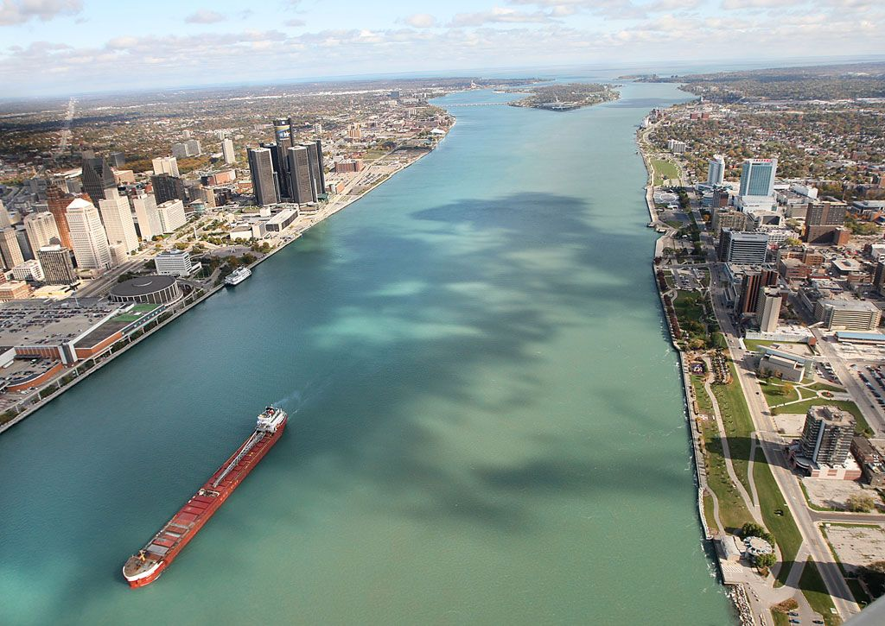
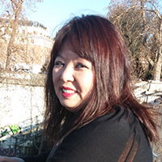
Closing Remarks
Recap Meeting
***
Thank you so much for participating under the current circumstances!
We hope you find our new AGM format useful and informative.
Special thanks to Elyse Larsen, UMich for registration hosting.
Our next webinar will be at the end of Dec, stay tuned for more info.
Take care of each other and stay safe & healthy!
SCDRSI
Elyse Larsen
Registration Coordinator

